Slide 1
(The Irish Version of Their Origins)

Slide 2
You’ll notice the parentheses around the presentation title. That’s because, instead of picking up from the previous cliffhanger, we’re going to talk a bit about where the Irish themselves think they come from.
Lebor Gabála Érenn (“The Book of the Invasions of Ireland”), produced in the 11th century, is a collection of partly historical, mostly fictitious (according to modern scholars) stories about the origins of the Irish. According to this work, there were a couple of false starts in the settling of Ireland, one in which the inhabitants were destroyed by the biblical flood & another in which all were destroyed by a plague. Finally, around 2350 B.C., a man named Nemed led a group of colonists from the Black Sea area to Ireland. They managed to force the Fomorians, some sort of semi-supernatural monster race (there doesn’t seem to be a story about how THEY got to Ireland), to build for them, and they lived on the island for 216 years, until the Fomorians managed to revolt & slay the majority of the Nemedians. The survivors fled the island, & one named Semeon settled in Greece, where he grew fruitful & multiplied.
Semeon’s descendants were enslaved, but after a couple of centuries, 5000 of them fled back to Ireland. These people are called the Fir Bolg, & as you study the origins of Ireland, that’s a name you come across a lot (unlike all those that precede this group). They supposedly arrived on the island around 1934 B.C. & divided the land into five provinces with kings, who fought among themselves.
The Fir Bolg are more than myth, although it’s hard to tell where myth ends & reality begins. It is believed they settled the western part of Ireland, including the Aran islands. Interestingly, the west has been somewhat isolated from the rest of the island, & more native Gaelic survives there than anywhere else on the island. According to http://irishimbasbooks.com/the-last-of-the-fir-bolg-irish-mythology/, “these days, the general academic consensus is that the Fir Bolg were an early Celtic group.” That would be exciting news for us, but the author is overstating the matter considerably when he claims that this theory is a consensus among scholars.

Slide 3
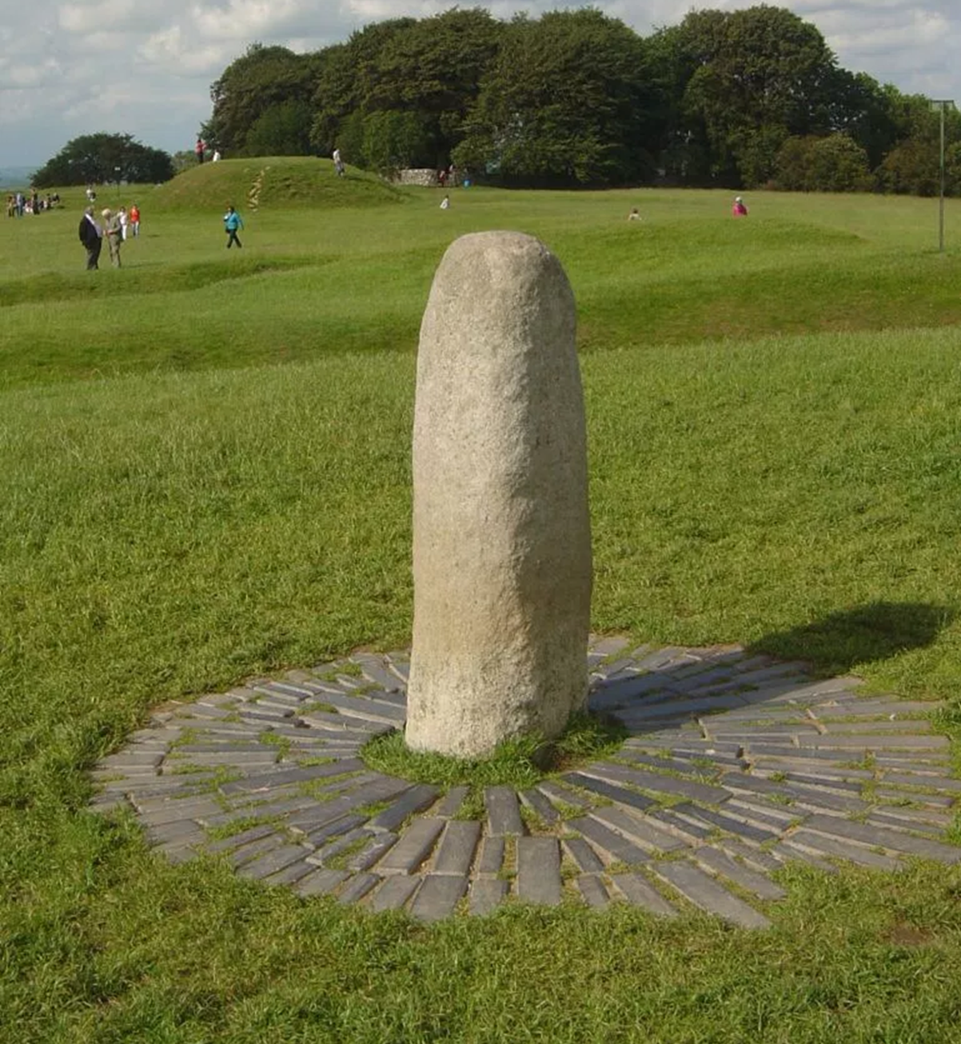
Meanwhile, back on the continent (some say eastern Asia), another group of Nemed’s descendants, called the Tuatha de Danaan (“People of the goddess Danu”) decided to head home to Ireland. A mere 37 years after the arrival of the Fir Bolg, these people came & defeated them. The Tuatha de Danaan apparently possessed skills & knowledge that made them appear, from a later point of view, to be a supernatural race. There is a carved stone on the Hill of Tara (the site where the high kings of Ireland were crowned) called “Lia Fail” (“Stone of Destiny”) that the Tuatha de Danaan were said to have brought. Supposedly, the stone would shout out in approval when the new king touched it. The Tuatha de Danaan brought 3 other magic items (a spear, a sword, & a cauldron), but those items haven’t survived. (That’s not to say that the stone that currently occupies the spot of honor on the Hill of Tara actually came with the Tuatha de Danaan, whoever those people actually were.)

Slide 4
The next conquerors of Ireland are called Milesians and came from Spain. An elderly Spanish man purportedly spotted Ireland from atop a high tower & decided to sail there around 1700 B.C. Long story short, the Tuatha de Danaan killed him, & his son, Mil Espaine (“soldier of Spain”), and grandsons sailed to Ireland to exact retribution. Mil died en route, but the two younger men defeated the Tuatha de Danaan and divided the island between them.
Today’s Irish descend from Mil Espaine…according to tradition. But remember, we’re talking about stories put on paper in the 11th century A.D. to tell about events that had happened three or four millennia earlier. Nevertheless, for centuries those stories influenced how the Irish viewed themselves.

